Slide 1
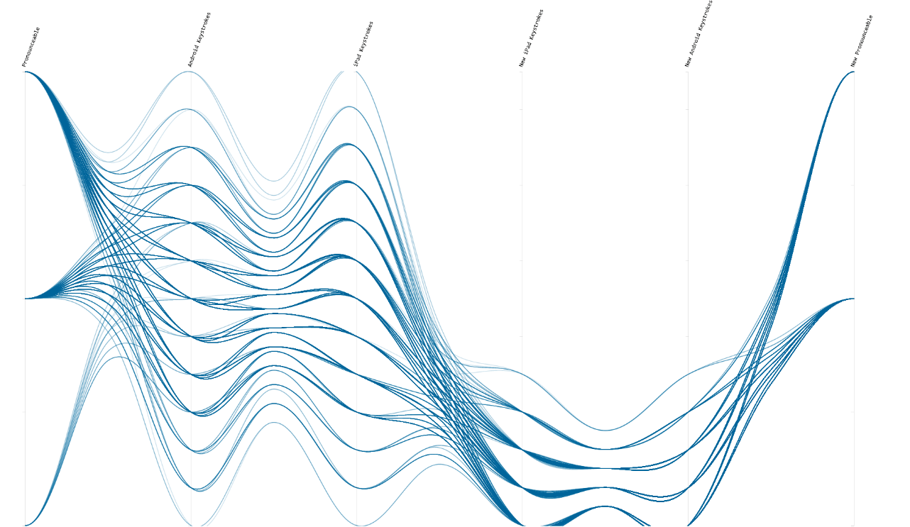
information VISUALIZATION
Cathryn Ploehn

Slide 2
What is visualization?
◕ ◡ ◕

Slide 3
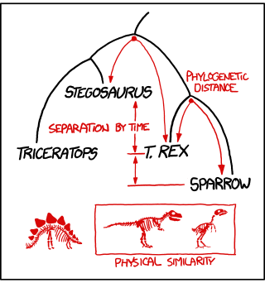

Slide 4
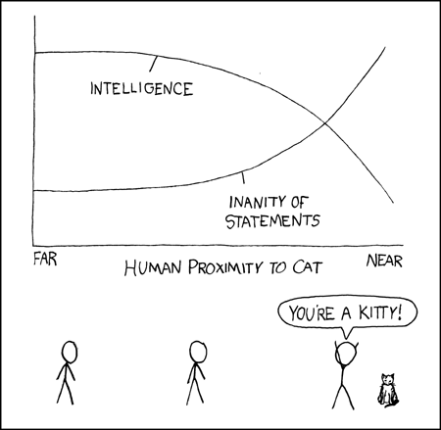

Slide 5
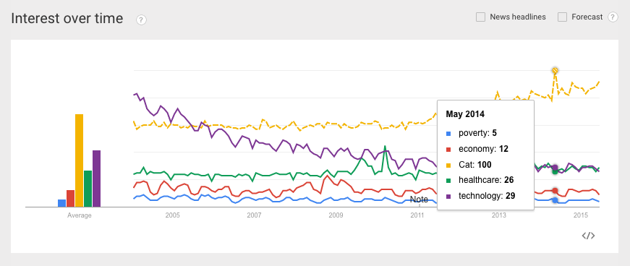

Slide 7
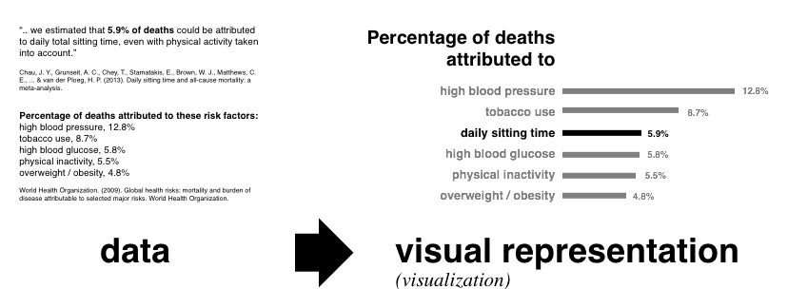

Slide 11
Visualization is a study of transformation from data to visual representations
“
Chen et al. 2014

Slide 12
Visualization is a study of transformation from data to visual representations in order to facilitate ↴
“
Chen et al. 2014

Slide 13
Visualization is a study of transformation from data to visual representations in order to facilitate ↴ effective and efficient cognitive processes in performing tasks involving data."
“
Chen et al. 2014

Slide 14
Visualizations facilitate effective and efficient cognitive processes

Slide 15
Visualizations facilitate performing tasks involving data

Slide 17
What is information visualization?
◕ o ◕

Slide 18
What is information visualization?
visual analytic tools for exploring and extracting patterns from abstract data.

Slide 19
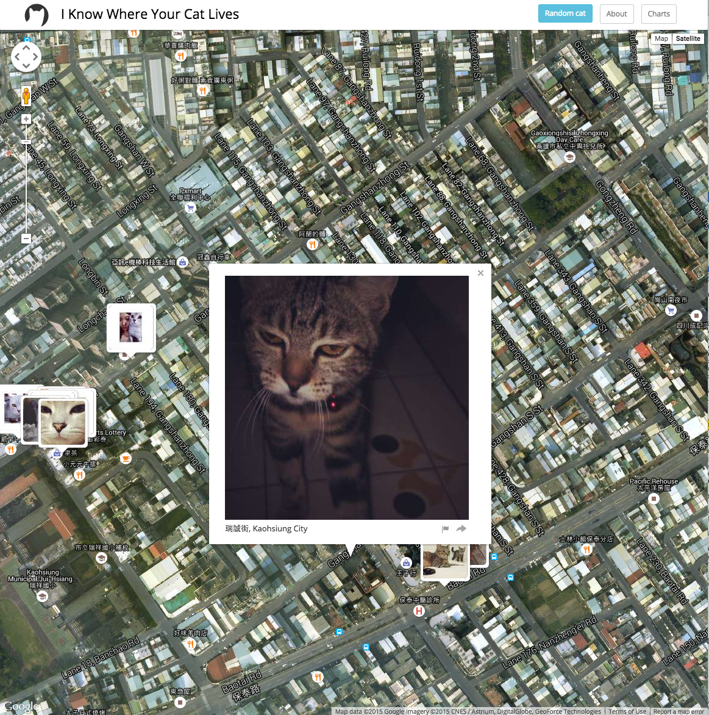

Slide 20
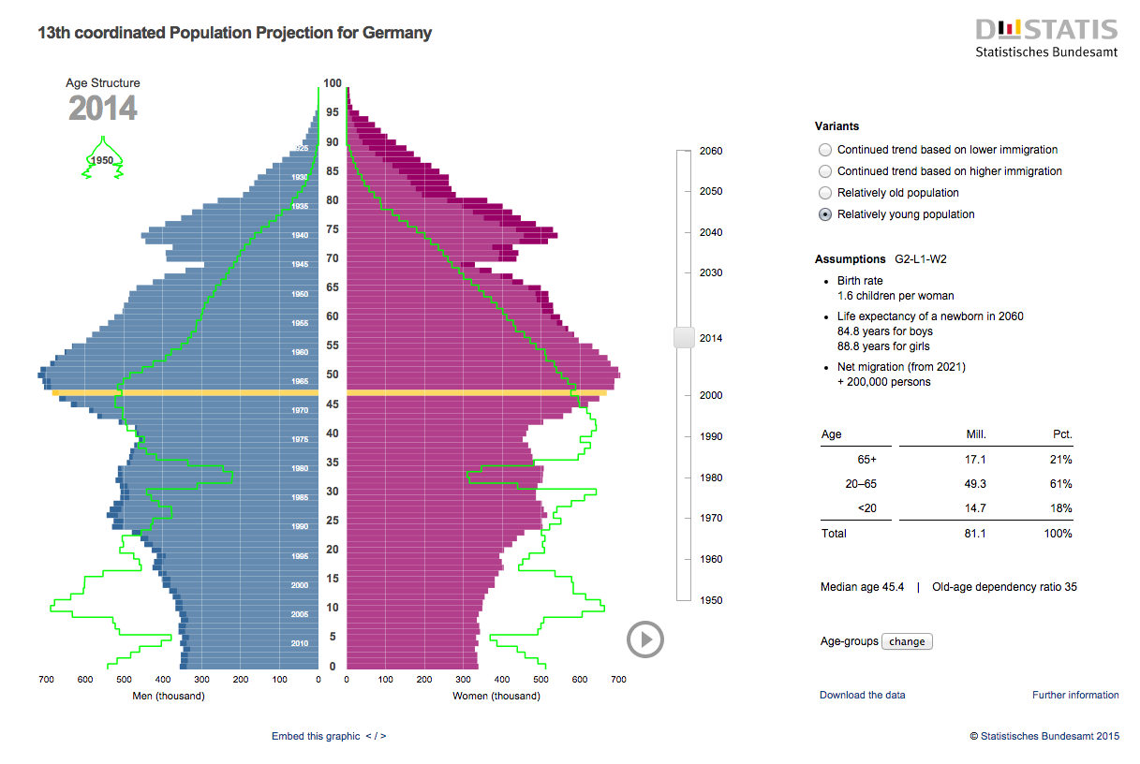

Slide 22
why create visualizations?
◑⥐◑

Slide 23
"The graph retains the information in the data"
Cleveland 1994

Slide 24
why create visualizations?
Explore data structure
“Convey the wealth of information that exists in data”
Encounter surprises in the data
"strengthen our mental abilities"

Slide 25

Visualization saves time.
Chen et al. 2014

Slide 27
how do you assess information visualization?
Very carefully

Slide 28
Evaluation methods

Slide 29
Evaluation methods

Slide 31
designing a visualization evaluation

Slide 32
Challenges in visualization evaluation
» demonstrate utility of a tool in real settings
» capture the full range of complex tasks a user performs
» development of task-feature taxonomies is also needed
» reusability & reproducibility of eval frameworks
» verification, and validation of eval frameworks

Slide 33
Challenges in visualization evaluation
» create benchmark data sets and tasks
» increase the rigor of reporting methodology
» increased focus on context
» better understanding of the qualitative approach
» avoid demand characteristic effects

Slide 34
“
Visualization is a study of transformation from data to visual representations in order to facilitate ↴ effective and efficient cognitive processes in performing tasks involving data."
Chen et al. 2014

Slide 35
“
Visualization is a study of transformation from data to visual representations in order to facilitate ↴ effective and efficient cognitive processes in performing tasks involving data."
Chen et al. 2014

Slide 36
cognition, usability, tasks
are core to the purpose of information visualization

Slide 37
context

Slide 38
many researchers urge a context-based approach
Plaisant 2004, Shneiderman and Plaisant 2006, Perer and Shneiderman 2009, Lam et al. 2012, Isenberg et al. 2013

Slide 39
context-based evaluations are critically needed
very relevant to the underlying goal and purpose
of visualizations in the data analysis process

Slide 40
Challenges in visualization evaluation 1
» demonstrate utility of a tool in real settings
» capture the full range of complex tasks a user performs
» development of task-feature taxonomies is also needed
» reusability & reproducibility of eval frameworks
» verification, and validation of eval frameworks

Slide 41
Challenges in visualization evaluation 2
» create benchmark data sets and tasks
» increase the rigor of reporting methodology
» increased focus on context
» better understanding of the qualitative approach
» avoid demand characteristic effects

Slide 43
What is a context-based approach?

Slide 44
Evaluation goals for a context-based approach
» Understanding environments and work practices
Understanding people’s work, analysis, or information processing practices
» Evaluating visual data analysis and reasoning
How visualization tools support “analysis and reasoning and helps to derive relevant knowledge from data
» Evaluating communication through visualization
Assessment of "communicative value of a visualization or visual representation in regards to user goals
» Evaluating collaborative data analysis
Extent to which a visualization tool supports groups to conduct collaborative data analysis
Lam et al. 2012

Slide 45
Evaluation methods
»
«

Slide 46
Example of case study format
» Interview:
Figuring out the intentions of the domain experts, which is one benchmark of success.
» Training:
Users attend a training session with tool developers and receive a training manual.
» Early use (2 - 4 weeks)
Domain experts begin using the tool in their work place. Observers visit the workplace to interview on progress. Developers address user needs by adding features to the visualization tool and provide technical support.
» Mature use
Somewhat "ethnographic" style observation. No additional help or upgrades from developers.
» Outcome
Exit interview with domain experts. Explain how software impacted research.
Perer and Shneiderman 2009

Slide 47
Evaluation goals for a context-based approach
» Understanding environments and work practices
Understanding people’s work, analysis, or information processing practices
» Evaluating visual data analysis and reasoning
How visualization tools support “analysis and reasoning and helps to derive relevant knowledge from data
» Evaluating communication through visualization
Assessment of "communicative value of a visualization or visual representation in regards to user goals
» Evaluating collaborative data analysis
Extent to which a visualization tool supports groups to conduct collaborative data analysis
Lam et al. 2012

Slide 48
Evaluating visual data analysis and reasoning
Goals:
How does visualization support data exploration processes?
How does visualization support knowledge discovery?
How does visualization support hypothesis generation?
How does visualization support decision making?

Slide 49
Evaluating visual data analysis and reasoning
Methods:
Case studies
Laboratory observation and interviews
Controlled experiment

Slide 50
a focus on the purpose of visualization in the data analytic process
In conclusion,

Slide 51
Questions?

Slide 53
Evaluation goals for a context-based approach
» Understanding environments and work practices
Understanding people’s work, analysis, or information processing practices
» Evaluating visual data analysis and reasoning
How visualization tools support “analysis and reasoning and helps to derive relevant knowledge from data
» Evaluating communication through visualization
Assessment of "communicative value of a visualization or visual representation in regards to user goals
» Evaluating collaborative data analysis
Extent to which a visualization tool supports groups to conduct collaborative data analysis
Lam et al. 2012

